Slide 1


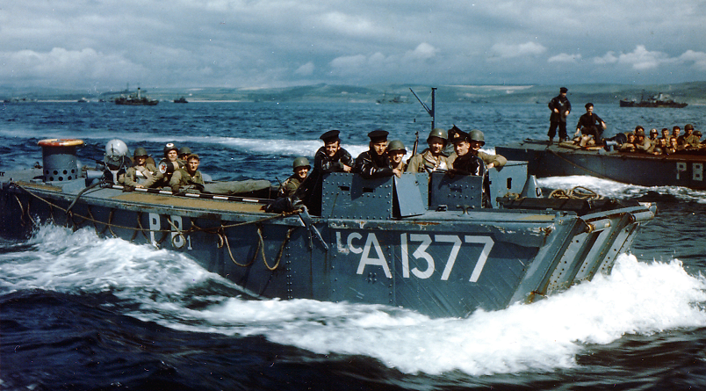


MAIORI
HMS LEDBURY
4° RANGER
LCA
TORRENTE REGINNA
3° RANGER
1° RANGER
MAPPA 1 (09/09/43)

Slide 2

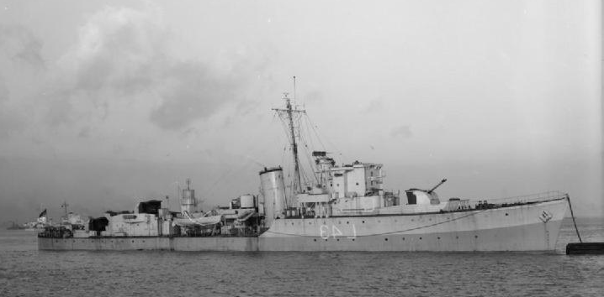
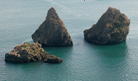



MARINA DI VIETRI
41° ROYAL MARINE COMMANDO
HMS BLACKMORE
2° ARMY COMMANDO
TORRENTE BONEA
5 LCA
SCOGLI DEI DUE FRATELLI
MAPPA 2 (09/09/43)

Slide 3
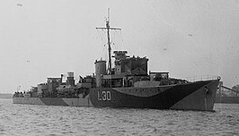
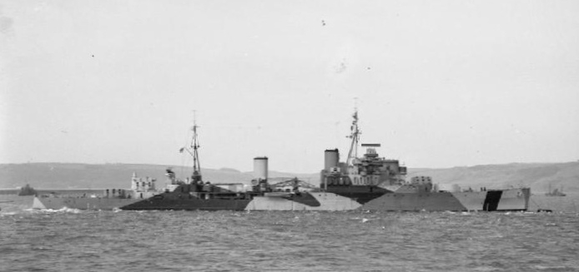
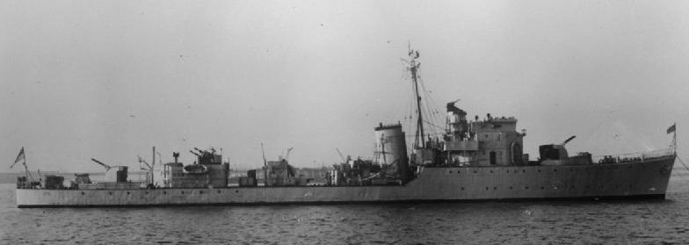
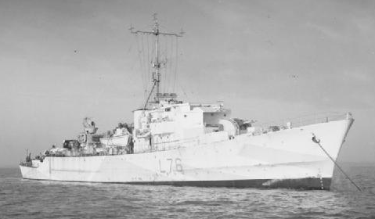
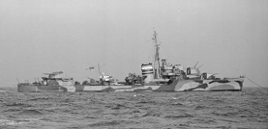
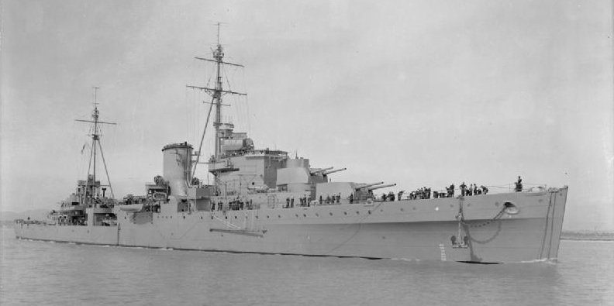
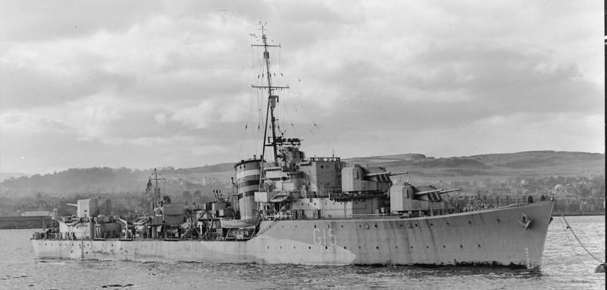
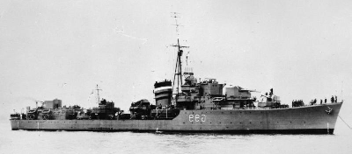
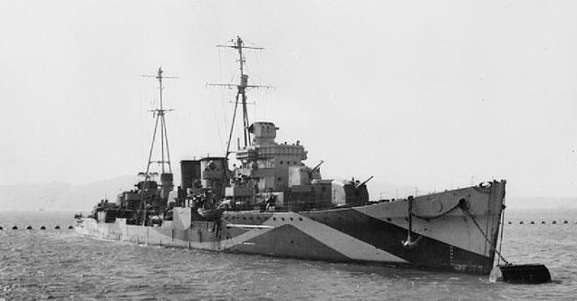
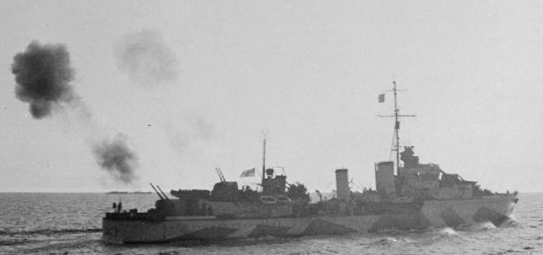
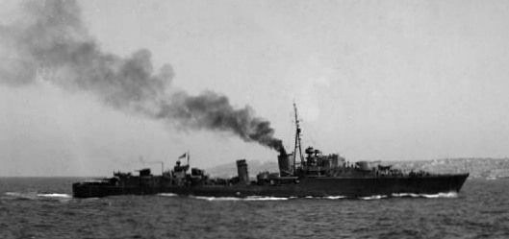
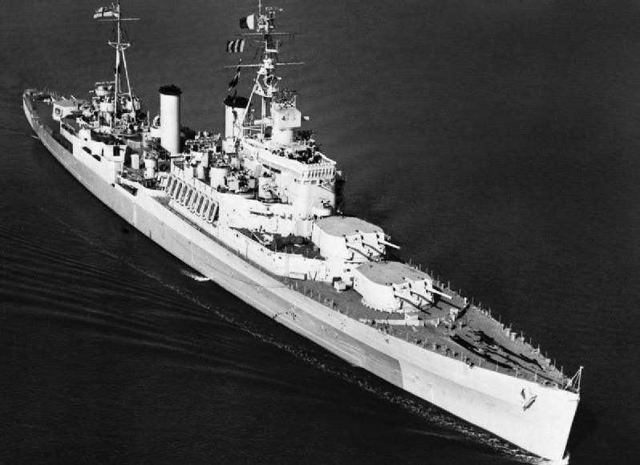
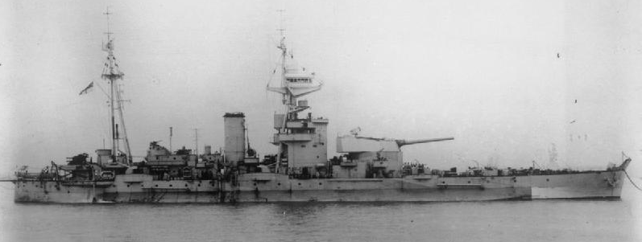
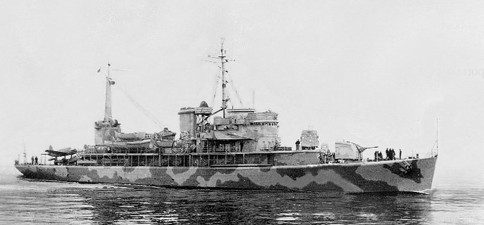
TASK FORCE 85
HMS BLANKNEY
UNCLE BEACH
HMS MENDIP
HMS MAURITIUS
HMS BRECON
HMS LOOKOUT
HMS LOYAL
SUGAR BEACH
HMS ORION
HMS LAFOREY
HMS TARTAR
HMS DELHI
HMS NUBIAN
HMS ROBERTS
ROGER BEACH
HMS UGANDA
USS BISCAYNE
MAPPA 3 (09/09/43)

Slide 4




UNCLE BEACH
FIUME PICENTINO
1/4° HAMPSHIRE REGIMENT
CAPOSALDO MOLTKE
UNCLE
RED
LCA
LCA
UNCLE
GREEN
5° HAMPSHIRE REGIMENT
2° HAMPSHIRE REGIMENT
CAPOSALDO LILIENTHAL
FIUME ASA
MAPPA 4 (09/09/43)

Slide 5



SUGAR BEACH
CAPOSALDO LILIENTHAL
FIUME ASA
LCA
2°HAMPSHIRE REGIMENT
SUGAR
AMBER
2/5°QUEEN’S REGIMENT
LCA
SUGAR
GREEN
2/6° QUEEN’S REGIMENT
2/7° QUEEN’S REGIMENT
FIUME TUSCIANO
MAPPA 5 (09/09/43)

Slide 6


ROGER BEACH
FIUME TUSCIANO
LCA
ROGER
AMBER
CAPOSALDO SCHARNHOST
8° ROYAL FUSILIERS
LCA
ROGER
GREEN
7° OXFORDSHIRE AND BUCKINGHAMSHIRE LIGHT INFANTRY
9° ROYAL FUSILIERS
MAPPA 6 (09/09/43)

Slide 7
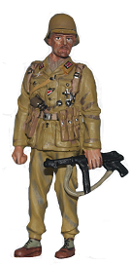



CAPOSALDO LILIENTHAL
CAPOSALDO
LILIENTHAL
2° HAMPSHIRE
REGIMENT
UNCLE
GREEN
LCA
5° HAMPSHIRE
REGIMENT
CAPOSALDO
LILIENTHAL
LCA
FIUME ASA
2/5° QUEEN’S
REGIMENT
2° HAMPSHIRE
REGIMENT
MAPPA 7 (09/09/43)

Slide 8

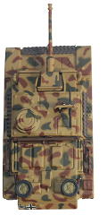

HAMPSHIRE LANE
2/64° PANZERGRENADIER-REGIMENT
2/2° PANZER-REGIMENT
5° HAMPSHIRE REGIMENT
MAPPA 8 (09/09/43)

Slide 9
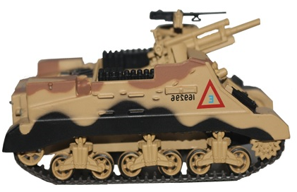
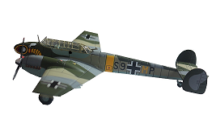

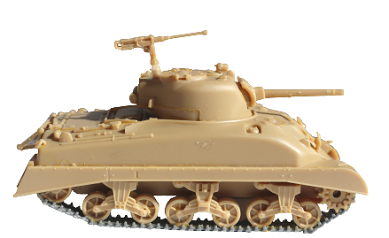
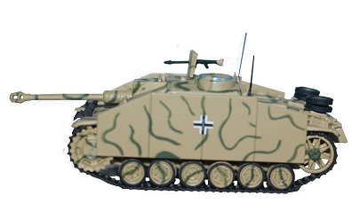
MONTECORVINO AIRFIELD
2/6° QUEEN’S REGIMENT
142° FIELD REGIMENT
ZG 1 WESPENGESCHWADER
PISTA DI VOLO
ROYAL SCOTS GREYS
C SQUADRON
MAPPA 9 (09/09/43)

Slide 10
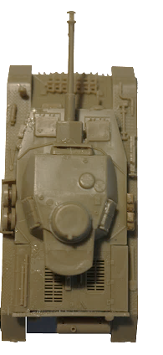
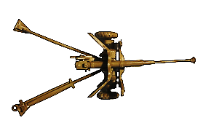
VIETRI SUL MARE
2/2° PANZER-REGIMENT
41° ROYAL MARINE COMMANDO
STATALE 18
MAPPA 10 (09/09/43)

Slide 11
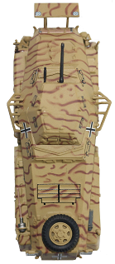
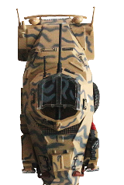
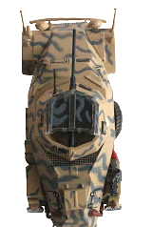
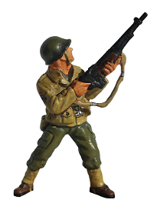


CHIUNZI PASS
PANZER-AUFKLARUNGS-ABTEILUNG HERMANN GOERING
FORT SCHUSTER
3° RANGER
MAPPA 11 (09/09/43)

Slide 12
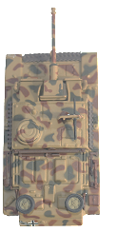


CAVA DE’ TIRRENI
3° STURMGESCHUTZ ABTEILUNG HERMANN-GOERING
CHIESA DELLA MADONNA DELL’OLMO
2/1° PANZERGRENADIER-REGIMENT
HERMANN GOERING
QUINTA COMPAGNIA
PONTE DI SAN FRANCESCO
46° RECCE REGIMENT B SQUADRON
MAPPA 12 (09/09/43)

Slide 13
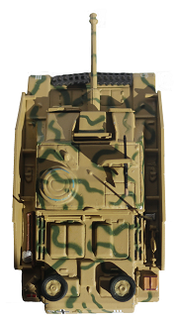
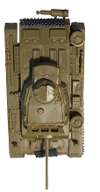
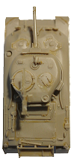
FASANARA
3/2° PANZER-REGIMENT
8° ROYAL FUSILIERS
ROYAL SCOTS GREYS A SQUADRON
MAPPA 13 (09/09/43)

Slide 14
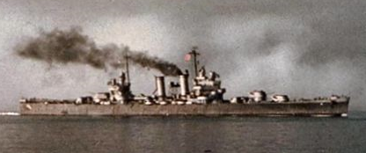
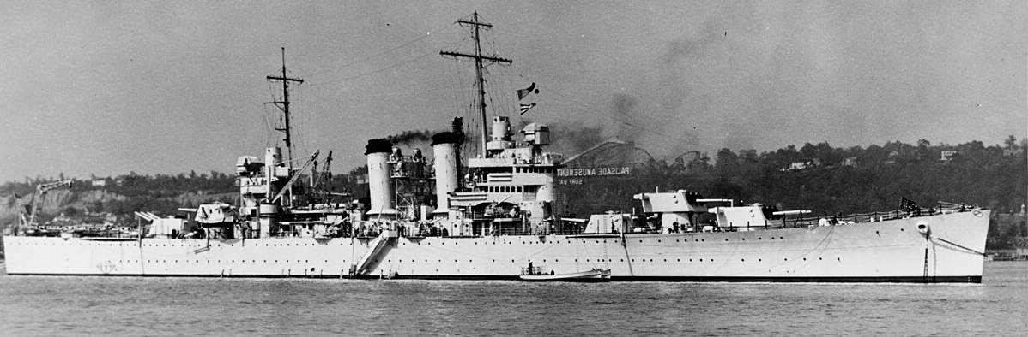
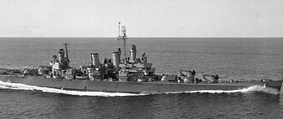
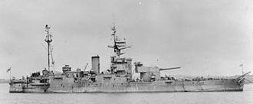
TASK FORCE 81
RED
BEACH
USS. PHILADELPHIA
GREEN
BEACH
USS. BROOKLYN
YELLOW
BEACH
USS. SAVANNAH
HMS ABERCROMBIE
BLUE
BEACH
MAPPA 14 (09/09/43)

Slide 15



PAESTUM
RED
BEACH
1/142°RCT
3/142° RCT
111°ENGINEER BATTALION
2/142° RCT
GREEN
BEACH
YELLOW
BEACH
2/141°RCT
3/531°SHORE ENGINEER
3/141° RCT
TORRE DI PAESTUM
BLUE
BEACH
FIUME CAPODIFIUME
1/141° RCT
MAPPA 15 (09/09/43)

Slide 16


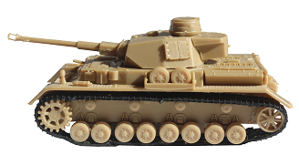

BLUE BEACH
6 LCVP
12 LCVP
FIUME CAPODIFIUME
1/141°RCT
MAPPA 16 (09/09/43)

Slide 17
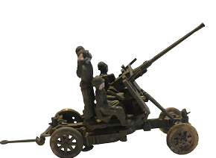

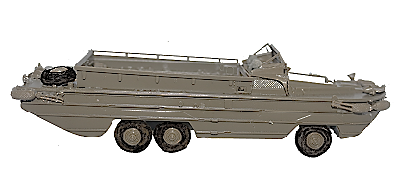
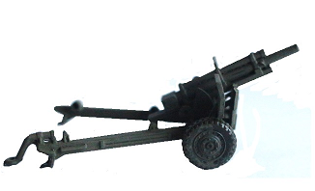
YELLOW BEACH
6 LCVP
12 LCVP
TORRE DI PAESTUM
2/141° RCT
3/531°SHORE ENGINEER
3/141° RCT
MAPPA 17 (09/09/43)

Slide 18

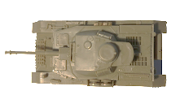


CASA VANNULO
1/79° PANZERGRENADIER-REGIMENT
2/2° PANZER-REGIMENT
CASA VANNULO
36° CAVALRY RECONNAISSANCE TROOP
STATALE 18
151° FIELD ARTILLERY BATTALION
3/142° RCT
MAPPA 18 (09/09/43)

Slide 19
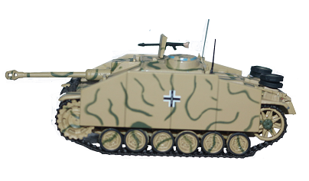
CONSERVIFICIO BARATTA (TOBACCO FACTORY)
16° PIONIER-BATAILLON
SECONDA COMPAGNIA
2° SCOTS GUARDS
3/2° PANZER-REGIMENT
MAPPA 19 (11/09/43)

Slide 20
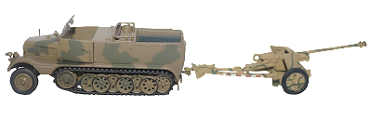

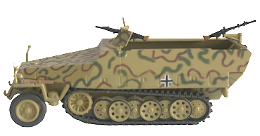
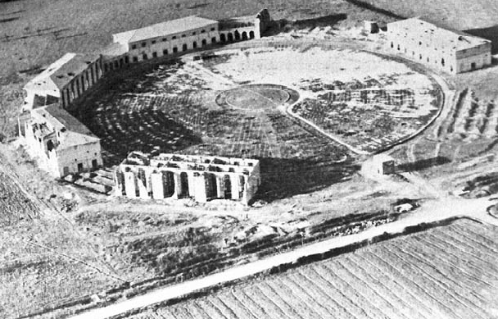
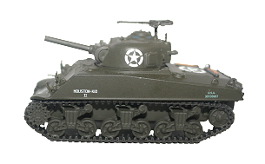
TABACCHIFICIO SAIM
(TOBACCO FACTORY)
1/79° PANZERGRENADIER-REGIMENT
191° ARMORED BATTALION
MAPPA 20 (11/09/43)

Slide 21

TABACCHIFICIO SAIM
(TOBACCO FACTORY)
TABACCHIFICIO SAIM
(TOBACCO FACTORY)
1/79° PANZERGRENADIER-REGIMENT
1/79° PANZERGRENADIER-REGIMENT
1/157° RCT
1/157° RCT
2/2° PANZER-REGIMENT
2/2° PANZER-REGIMENT
191° ARMORED
BATTALION
191° ARMORED
BATTALION
MAPPA 21 (12/09/43)

Slide 22
DRAGONEA
CHIESA PARROCCHIALE DEI SANTI PIETRO E PAOLO
2/1° PANZERGRENADIER-REGIMENT HERMANN GOERING
SESTA COMPAGNIA
VIA VALLONE
2° ARMY COMMANDO
CHIESA PARROCCHIALE DI BENINCASA
41° ROYAL MARINE COMMANDO
MAPPA 22 (13/09/43)

Slide 23
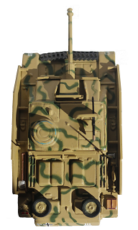


IL PONTE SUL FOSSO
3/2° PANZER-REGIMENT
2/64° PANZERGRENADIER-REGIMENT
PONTE SUL FOSSO
FIUME TUSCIANO
9° ROYAL FUSILIERS
3° COLDSTREAM GUARDS
ROYAL SCOTS GREYS A SQUADRON
MAPPA 23 (13/09/43)

Slide 24
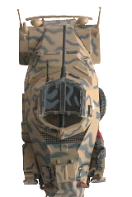
IL LUNEDI’ NERO
1/79°PANZERGRENADIER-REGIMENT
2/2° PANZER-REGIMENT
26° AUFKLARUNGS- ABTEILUNG
1/157° RCT
MAPPA 24 (13/09/43)

Slide 25
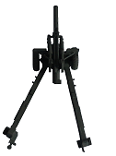
BURNED BRIDGE
2/2° PANZER-REGIMENT
GUADO
FIUME CALORE
158° FIELD ARTILLERY BATTALION
189° FIELD ARTILLERY BATTALION
MAPPA 25 (13/09/43)

Slide 26



LA COSA CREEK
2/2° PANZER-REGIMENT
JINX
MAPPA 26 (14/09/43)

Slide 27


FILETTA
3/129° PANZERGRENADIER-REGIMENT
3°STURMGESCHUTZ ABTEILUNG HERMANN GOERING
7° OXFORDSHIRE AND BUCKINGHAMSHIRE LIGHT INFANTRY
44° RECONNAISSANCE REGIMENT
40° ROYAL TANK REGIMENT A SQUADRON
MAPPA 27 (15/09/43)

Slide 28




MOLINA PASS
POSTO DI BLOCCO COSTIERO (P.B.C. 31)
3° STURMGESCHUTZ ABTEILUNG HERMANN GOERING
STATALE 18
2/1° PANZERGRENADIER-REGIMENT HERMANN GOERING QUINTA COMPAGNIA
MURI DI SBARRAMENTO
STRADALE
6° YORK AND LANCASTER REGIMENT
40° ROYAL TANK REGIMENT
MAPPA 28 (23/09/43)

Slide 29



PASSO DI CAMERELLE
OTTAVA COMPAGNIA PIONIER-BATAILLON HG
3° STURMGESCHUTZ ABTEILUNG HERMANN GOERING
STATALE 18
6° YORK AND LANCASTER REGIMENT
5° HAMPSHIRE REGIMENT
142° FIELD REGIMENT
5° ROYAL TANK REGIMENT
MAPPA 29 (28/09/43)

Slide 30
LA STRADA DELLA MORTE
5° ROYAL TANK
REGIMENT
VICOLO DE PASCALE
CORSO UMBERTO I
PANZER-REGIMENT
HERMANN GOERING
MAPPA 30 (28/09/43)

